Slide 1
Sprint 4
By Roman,Shabbar,Richard

Slide 2


Challenges
One of the challenges we faced was with the initial sprint are biggest problem was that we couldn't get our sphero to move along the line accurately but after many resets and orientation adjust we managed to get it to work.
The second sprint was the hardest for us because after the initial few loops we determined that the floor wouldn't provide enough friction and because of that our robot would get off course
The most difficult part of the third sprint was the slope that the robot had to go over. After it would go over the supposed hill, it was hard to get it to land consistently on the line.

Slide 3



Roles
Richard
Shabbar
Main writer for our SDD
Primarily in charge of the coding and the flowchart
Roman
Helped out with everything as a sort of manager but also worked heavily with the SDD’s tables

Slide 4
What I've learned (Roman)
I learned a lot about coding something during these projects as this was my first time applying it to a robot or anything in general
I learned how hard it is to manage a group which I had never done before
Coding anyobject to do something when you cant control all external forces(or just a little bit) is difficult ex: Second sprint

Slide 5
What I've learned (Shabbar)
From this project I learned how to code and properly do trial and error.
I also learned how to incorporate code and how to handle working with others and utilize their ideas into my work
I learned how to do a flowchart using a code

Slide 6
What I've learned (Richard)
I learned a different way to explain and communicate my ideas to my group.
I also learned how important teamwork is and how to incorporate others ideas into my own work and take suggestions to solve a common problem
When you can't control the environment around you in which the robot needs to perform it makes it much harder to get get the desired outcome you want. Ex. The tape on the ground creates an uneven ground so it's almost impossible to get the robot to travel in a perfect line.

Slide 7
What we would do differently
One thing that I know we would do differently if we had to tackle these is definitely giving ourselves more time/ more days to get the physical data like the video
Something I would do differently would be communicate better with my teammates. Additionally, I would balance the time better as well.
One thing I would’ve done differently was worded the SSD a bit differently and more in depth. I also would have managed my time better.

Slide 8
Sprint 3
Sprint three was a complex code compared to sprint 1 and sprint 2. There were more block codes involved and it took multiple tries. One of the biggest struggles was not creating the block code, but how inconsistently the robot would follow the path. There could not have been the slightest of change made with orientation and starting point of the robot.

Slide 9
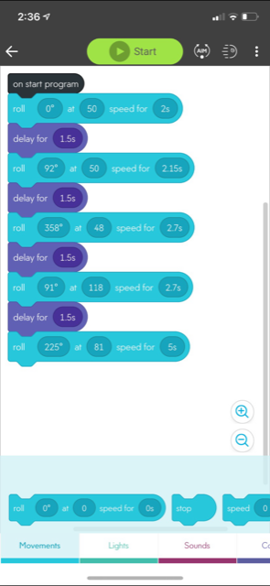
Block Code
This is the block code we used for the third sprint. The added delays help calm down the robot instead of it constantly running. The floor in the room does not have any friction so it would cause the robot to slide a lot. The delay stops it and helps the robot move more smoothly across the course.

Slide 10

Video

